Slide 1
Design Patterns
Shidlingayya G (Siddu)
Oct - 2022

Slide 2
Design Pattern Basics
Design Pattern Background?
A Design Pattern provides a general reusable solution for the common problems that occur in software design and implementation
They are like pre-made blueprints that you can customize to solve a recurring design problems in the code
Benefits of design patterns
Reusable
commonly occurring
Software
Solutions
Problems
Design
Solutions to General problems
Language Neutral
Design Patterns
Development process is fast
Proven patterns reduce technical risks
Best Practices
Highly flexible
(Used in any domain)
Obtained by Trial and Error

Slide 3
Design Pattern Types
Design Pattern types
Creational Patterns
Structural Patterns
Behavioral Patterns
Singleton
Adapter
Chain of Responsibility
Factory Method
Bridge
Command
Abstract factory
Composite
Iterator
Strategy
Decorator
Mediator
Builder
Template Method
Facade
Memento
Visitor
Prototype
Flyweight
Observer
Proxy
State

Slide 4
Design Pattern Types
Used in situations when basic form of object creation could result in design problems or increase complexity of a code base.
Focuses on object creation
Provides way to create objects while hiding the creational logic
Provides flexibility for creating objects based on different use cases
Creational Patterns
Relies on the relationship between objects
Provides the ways to club classes and object together to form large structures
Defines a manner for creating relationships between objects.
Structural Patterns
Provides way to communicate between objects
It describes how different objects and classes send messages to each other to make things happen
Increasing flexibility between object communication
Behavioral Patterns

Slide 5
Factory
It allows us to create objects without exposing the creation logic to the client
Client uses the same common interface to create a new type of object
Factory pattern also called as virtual constructor
Provides loose coupling and high cohesion (i.e component does only one thing and clearly defined role)
This pattern is useful when you need to decouple the creation of an object from its implementation
Ex: Memory Storge type – It can be Data base, JSON or Flat file based on need & client need not know about implementation details
Data base
Factory
(Memory Storage instances)
Memory Storage Type
Storage Request
JSON File
Flat File

Slide 6
Factory
Why Factory Pattern?
Consider below example of choosing memory type for storing configuration information:
https://github.com/shidlingayya/DesignPatterns/blob/main/FactoryPatternProblem.cpp
Assume that the choosing memory storage type is introduced new type – then client needs to update the code to accommodate the new memory storage type – This is bad design because strong coupling is introduced between library and client code.
Solving issue with Factory pattern:
The coupling can be avoided using factory pattern with static method interface
https://github.com/shidlingayya/DesignPatterns/blob/main/FactoryPatternSolution.cpp
Benfits
Hides object creational logic by using interface and factory classes
Unit testing makes easy – we can use stubs and mock easily due to loose coupling of code
Extendibility of code becomes easy due to loose coupling

Slide 7
Factory Design Pattern Limitations
More number of classes
Clients might have to sub-class the creator class just to create a particular concrete product object
Profile
Driver
+skillset()
+main():void
Asks
Software profile
Quality profile
Testing profile
Profile Factory
+skillset()
+skillset()
+skillset()
Creates
+skillset
+skillset()
+skillset()
+getProfile():Profile
This is extra class for creating object of product object

Slide 8
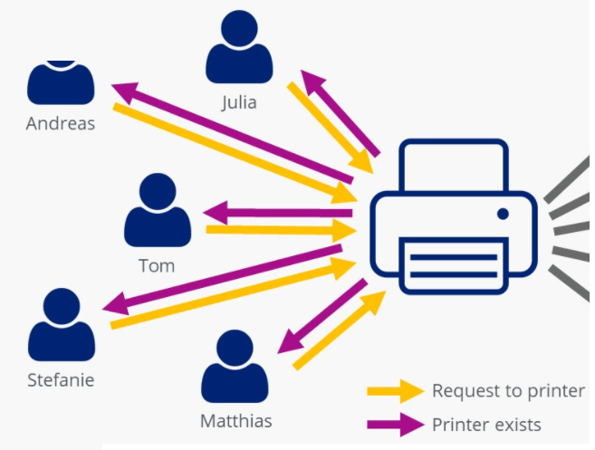
Singleton
Ensure that a class has only single instance, while providing a global access point to this instance
A Singleton encapsulates a unique resource and makes it readily available throughout the application
The resource might be hardware, a network service, a persistent store, or anything else that can be modeled as a unique object or service
Ex: Printer Management system
Client-1
Unique resource instance
Client-2
Client-3
Client-N

Slide 9
Singleton Implementation...
When to use Singleton?
When a class in your program should have just a single instance available to all clients
Ex: Single data base for all applications, Logging, Printer management system or database connection etc
Use the Singleton pattern when you need stricter control over global variables
Implementation Details
Provide global static method to create the instance of single ton class
Make the constructor as a private to avoid direct access of new operator to clients
Example Implementation:
https://github.com/shidlingayya/DesignPatterns/blob/main/Singleton.cpp

Slide 10
Singleton limitations
Glorified global state:
It is difficult to debug the issue because singleton is global state need to analyze all the code which access singleton
Assume that – If any application modified the global state, then user need to debug all application where singleton being used
App3
App2
App4
App1
AppN
Mutable State
Singleton Instance
Tight coupling
The applications which uses singleton introduce tight coupling as a change to global data may impact to other application

Slide 11
Singleton limitations continued...
Hiding dependencies
The singleton class only exposes Singleton.getInstance() method to its clients..
But actual implementation inside constructor is private to the class and there can be lot more things might be handled inside the function..
What clients see
What actual it might be?
CertManagement
(Cert_types)
CertManagement
GenericPersistent
SecurePersistent
FIPSMode Logic check
File System Init
File System Init

Slide 12
Singleton limitations continued...
Violate the single responsibility principle:
Singleton virtue of the fact that they control their own creation and lifecycle hence it violates principle of single responsibility principle from OOPS..
Ex: Cert management class – which updates, reads and validates the device certificates in singleton class implementation
Update Cert
Get Cert
All functionalities handled in single class
CertManagement
Validate cert date
CreateX509 cert
Singleton hinder unit testing:
A Singleton might cause issues for writing testable code if the object and the methods associated with it are so tightly coupled that it becomes difficult to test without writing a fully-functional class dedicated to the Singleton
Singleton uses static methods make unit testing difficult since you cannot mock or stub

Slide 13
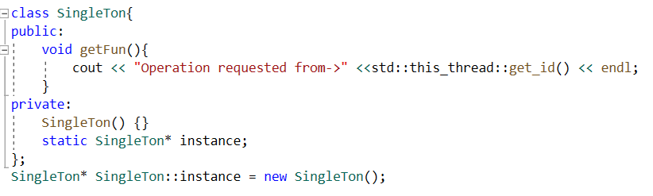
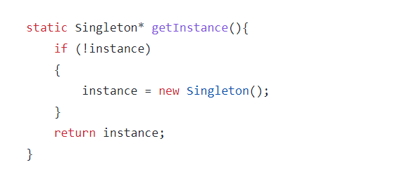
Proper way of Singleton Implementation
Eager Initialization
The instance of Singleton Class is created at the time of class loading
This instance is created even though client application might not be using it
This may cause memory leak if data base connection or socket connection is created, or file opened
This can be avoided by using “Lazy Initialization”
Lazy Initialization
Opposite to Eager initialization, here you are going to initialize new instance of the class in getInstance() method it self
This method will check if there is any instance of that class is already created
If already instance created, then it will return same instance else new instance will be created
Eager Initialization
Lazy Initialization

Slide 14
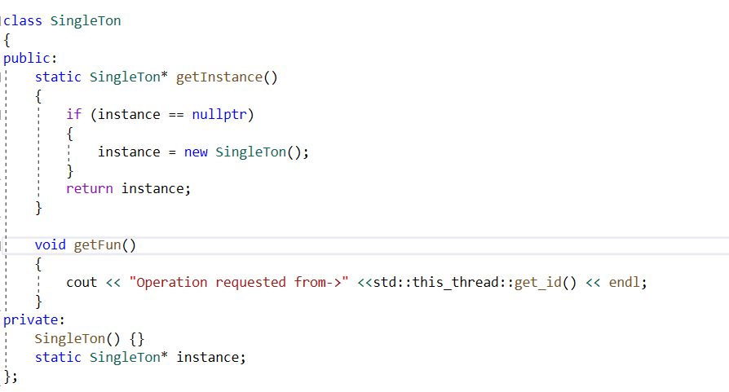
Proper Implementation of Singleton
Make Singleton thread safe
If two threads try to initialize the Singleton class at almost the same time, there can be chance that two instance of singleton may be created
This implementation is not thread safe because there is chance that multiple instance might gets created..
While executing getInstance() from thread1 it might go to suspended state for preempting scheduling & other thread2 try to getInstance() and end up creating new instance.. When thread1 is resumed it will create another instance
To make thread safe code – Need to use mutex in getInstance() method
std::lock_guard<std::mutex> myLock(myMutex)

Slide 15
Abstract Factory
Abstract factory is another creational design pattern
Abstract factory is similar to factory design pattern, and It is considered as another layer of abstraction over factory design pattern

Slide 16
Builder Design Pattern
It separates the construction process of object from its representation
This construction process can be used for constructing other similar types of representations as well
This design pattern will create ONE complex object(many steps required to create it). We can create different type of object(one at time) but construction process will be same for all type of object
There are 3 parts in Builder pattern:
Director
It has builder instance; it defines the construction process, and its same construction process can be used to create different type of object
Builder
It is abstract class, final product will be created by subclass build
Concrete Builder
This will create actual object

Slide 17
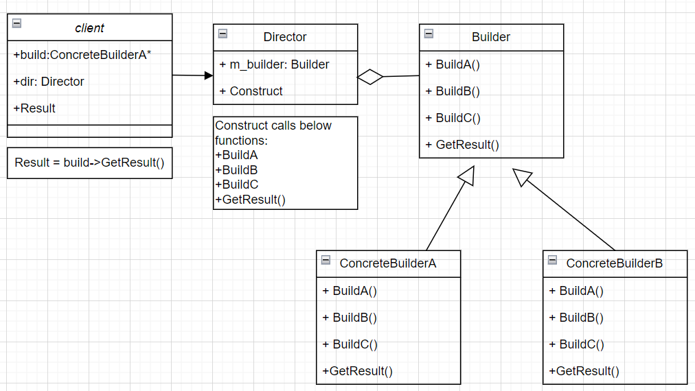
Builder Design Pattern continued…
Implementation Details
The builder design pattern can be implemented with different types of car model manufacturing
Example Implementation:
https://github.com/shidlingayya/DesignPatterns/blob/main/Builder_Design_Pattern.cpp

Slide 18
Prototype
Prototype is a creational design pattern that allows cloning objects, even complex ones, without coupling to their specific classes
Specify the kinds of objects to create using a prototypical instance, and create new objects by copying this prototype
In Layman language: It is same as that first writer gives the prototype of book then clone this and create many copy of it.
Problem it solves: We need a lots of similar objects, but basic object is same
Solution: We can take/preserve a basic object then on demand we can clone from it and add or remove some functionality to it if required and this solution called as “Prototype design pattern“.
At run time, we can add/remove prototype object
At run time, we can clone any number of objects on need basis
Advantages
Not required separate class hierarchy like factory design pattern to create product

Slide 19
Adapter Design Pattern
It allows us communication between incompatible or unrelated objects to collaborate
The Adapter acts as a wrapper between two objects
It converts programming interface of one class into that of another
The conversion can be in both the sides – This is called “two-way adapter”
Adapter
Convert XML->JSON format
Reference Platform message library
Product code
Message format in XML format
XML form
Message format in JSON Format
JSON form
Why to use Adapter Pattern?
Use the Adapter class when you want to use some existing class, but its interface isn’t compatible with the rest of your code.
The Adapter pattern lets you create a middle-layer class that serves as a translator between your code and a legacy class, a 3rd-party class or any other class with a weird interface.

Slide 20
Adapter Design Pattern
The adapter design pattern consists of 4 entities
Client – The user of target
Target - This is the interface with which the client interacts
Adapter - This is derived from Target and contains the object of Adaptee
Adaptee - This is the interface the client wants to interact with, but can’t interact without the help of the Adapter
Target
Adapter pattern relies on object composition
Client calls operation on Adapter object
Adapter calls Adaptee to carry out the operation
Adaptee
Adapter
The adapter design pattern insert middle layer which acts as interface between client and target https://github.com/shidlingayya/DesignPatterns/blob/main/AdapterDesignPattern.cpp
Benfits
The code is reusable and flexible
Help promote easier program changes and object reusability
Allow communication between a new and already existing system that is independent of each other

Slide 21
Adapter Design Pattern limitations
Multiple Inheritance required
The adapter design pattern needs multiple inheritance this conflicts occur when the same method exists in different parent classes
To implement in languages where multiple inheritance not supported – Adaptee or Target must be interface (JAVA)
Multiple Adaptors
You would require as many adapters as the client needs.
This may not be a problem for small applications. But bigger requirements implementation might complicate code
Product1 code
Adaptors
Message format in XML format
Reference Platform message library
XML form
XML to JSON
Message format in JSON Format
Product2 code
JSON form
Message format in Flat File format
FILE form
FILE to JSON

Slide 22
Bridge Design Pattern
Bridge is a structural design pattern that divides business logic or huge class into separate class hierarchies that can be developed independently
The bridge pattern allows the Abstraction and the Implementation to be developed independently and the client code can access only the Abstraction part without being concerned about the Implementation part
The abstraction contains a reference to the implementer
It increases the loose coupling between class abstraction and its implementation.
Bridge pattern promotes flexibility and allows us to change both the abstraction and implementation independently

Slide 23
Composite Design Pattern
Bridge is a structural design pattern that divides business logic or huge class into separate class hierarchies that can be developed independently
The bridge pattern allows the Abstraction and the Implementation to be developed independently and the client code can access only the Abstraction part without being concerned about the Implementation part
The abstraction contains a reference to the implementer
It increases the loose coupling between class abstraction and it’s implementation.

Slide 24
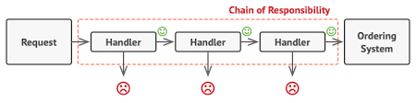
Chain of Responsibility
Chain of Responsibility is a behavioral design pattern that lets you pass requests along a chain of handlers. Upon receiving a request, each handler decides either to process the request or to pass it to the next handler in the chain
Chain of responsibility Pattern or Chain of Responsibility Method is a behavioral pattern, which allows an object to send a request to other objects without knowing who is going to handle it
This pattern is frequently used in the chain of multiple objects, where each object either handles the request or passes it on to the next object in the chain if it is unable to handle that request

Slide 25
Chain of Responsibility
Ex: An example that is suitable for implementing CoR is Approval Process of Purchase Requests.
In a company, any purchase below $500 does not require approval,
a Junior Associate can approve the order.
if the order exceeds $500, a Senior Associate needs to approve the order,
if the order exceeds $3,000 a manager needs to approve the purchase.
Ex: DesignPatterns/ChainOfResponsibilityExample.cpp at main · shidlingayya/DesignPatterns (github.com)

Slide 26
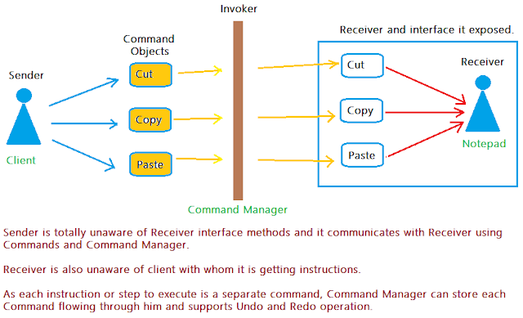
Command Design Pattern
The Command Pattern talks about encapsulating all the requests coming from the invoker in objects, passing them to the receiver, and letting the receiver take actions.
The conversion allows deferred or remote execution of commands, storing command history, etc
Command pattern used to encapsulate all information needed to perform an action or trigger an event at a later time.
Command Design pattern is used to decouple Sender and Receiver.
Sender is totally unaware of Receiver's interface and Receiver is unaware of Sender.
Resturant is a classic example of Command Pattern.
Customer(Invoker) is not aware of Chef(Receiver) and they communicate via Waiter(Command Manager) by giving Menu Name(Commands) to them.
Customer doesn't need to know how to communicate directly with Chef.

Slide 27
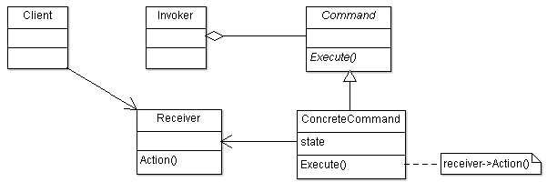
Command Design Pattern
UML diagram of command design pattern:
Example of command design pattern:
DesignPatterns/CommandDesignPattern.cpp at main · shidlingayya/DesignPatterns (github.com)

Slide 28
Iterator Design pattern
Iterator design pattern used to access and traverse an aggregate object without exposing its internal details
Provide a way to access the elements of an aggregate object sequentially without exposing its underlying representation.
Iterator will access elements of an aggregate and the aggregate would be something that holds data in a sequence of some sort, for example, an array of integers is an aggregate that holds integers in a sequence
Irrespective of complex data structure – Iterator is design pattern allows similar way of accessing data

Slide 29
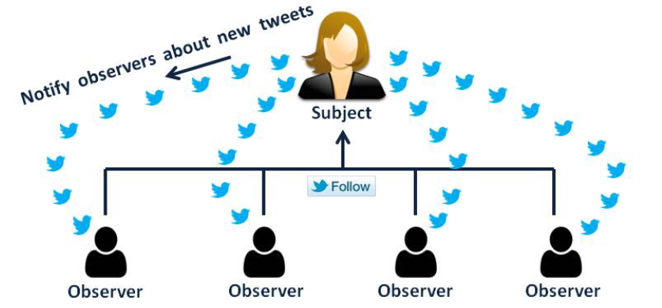
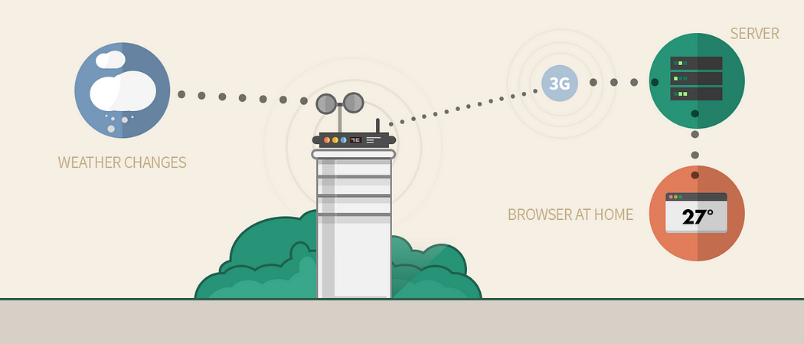
Observer Design Pattern
Provides infrastructure to subscribe and unsubscribe mechanism
We can use this pattern when multiple objects are dependent on the state of one object
Notify all the users about new tweet who are following user
Notify all apps(TV, Mobile etc) about weather changes
Why to use Observer Pattern?
Used when there is one-to-many relationship between objects such as if one object is modified, its dependent objects are to be notified automatically
Used in broadcast messaging applications (Ex: Shutdown notification)

Slide 30
Observer Design Pattern
The observer pattern contains below key concepts
Subject
This is object being observed. It maintains list of observers and notifies them of state changes
Observer
Observers are objects that are interested in stage changes of the subject. They are registered with the subject to receive updates
Concrete Subject
This concrete subject inherit from subject interface or class and is responsible for maintaining state and notifying observers when changes
Concrete Observer
This implements observer interface or inherit from an observer class. They register themselves with concrete subject and react to state changes

Slide 31
Observer Design Pattern
The One-to-many dependency exist between Subject and Observer
Observer1
The pub-sub model is different than observer pattern – the basic difference is in pub-sub model publishers and subscribers are loosely coupled and they unaware they communicate through broker.
No broker concept being used in observer pattern
Subject changed
Update
Subject
Observer2
Update
Update
Observer3
Example:
https://github.com/shidlingayya/DesignPatterns/blob/main/ObserverPattern.cpp
Benfits
No Impact to Subject class if observer list gets updated
Supports loose coupling of data
Observer can be added/deleted at any point of time

Slide 32
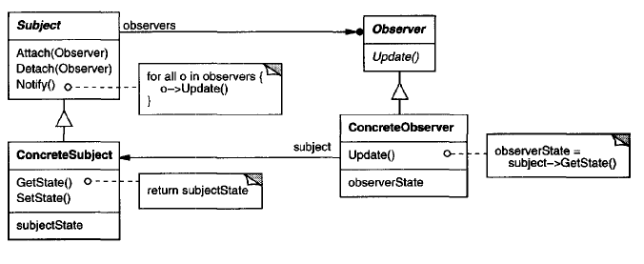
Observer Design Pattern
UML diagram of Observer design pattern
Example:
https://github.com/shidlingayya/DesignPatterns/blob/main/ObserverPattern.cpp
https://github.com/shidlingayya/DesignPatterns/blob/28167a37e597f7719bba29b25ef591416a8cd78f/
ObserverPattern.cpp

Slide 33
Observer pattern limitations
Memory leak issue
Memory leaks caused by Lapsed listener problem because of explicit register and unregistering of observers
In basic implementation, this requires both explicit registration and explicit deregistration, as in the dispose pattern, because the subject holds strong references to the observers, keeping them alive
The leak happens when an observer fails to unsubscribe from the subject when it no longer needs to listen

